Slide 1
Regression Tables
Siddhartha Lewis-Hayre

Slide 2
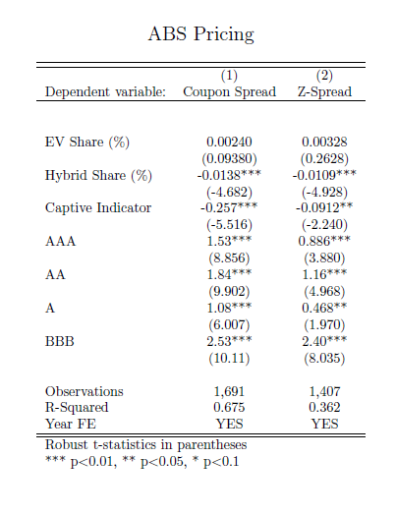
Purpose
Easy and automatic formatting
Saves coefficients and monitors for changed regressions

Slide 3
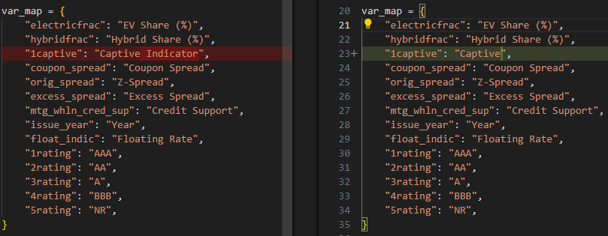
Example 1: Changing Labels
Change is almost instantaneous (regression not re-run)
Working on saving STATA variable names more effectively.

Slide 4
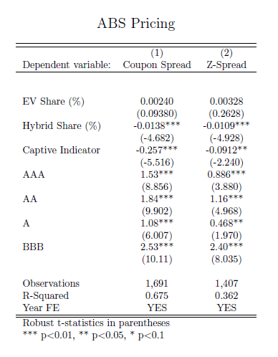
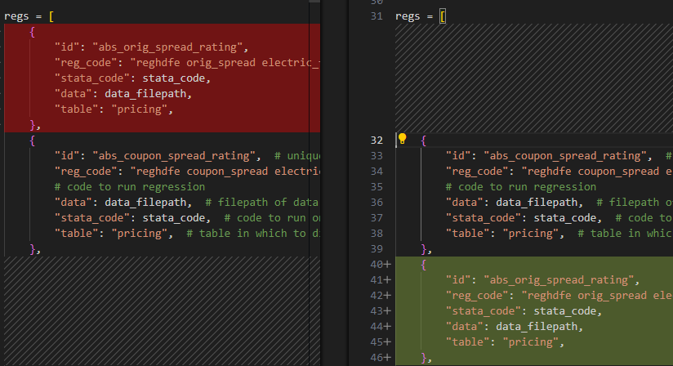
Example 2: Changing Column Order
Equivalent to Alt + ↑ 8 times
Change is almost instantaneous (regression not re-run)

Slide 5
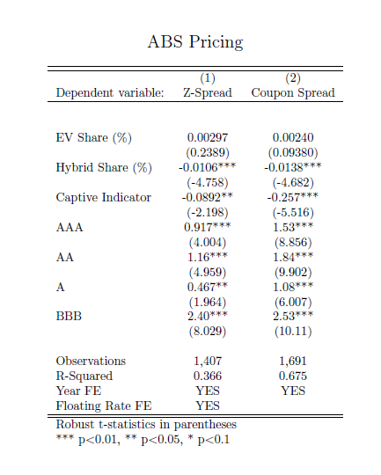
Example 3: Easily modifying regressions
reghdfe orig_spread electric_frac hybrid_frac i.captive ib5.rating, absorb(issue_year float_indic) vce(robust)
reghdfe orig_spread electric_frac hybrid_frac i.captive ib5.rating, absorb(issue_year ) vce(robust)
Code automatically only re-ran Z-Spread regression.

Slide 6

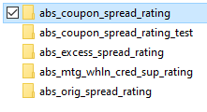

Outputs
PDF
Latex
Excel file
Stata file with coefficients

Slide 7
Inputs

Slide 8
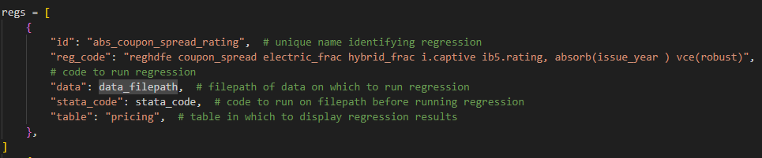
Code: Regressions

Slide 9
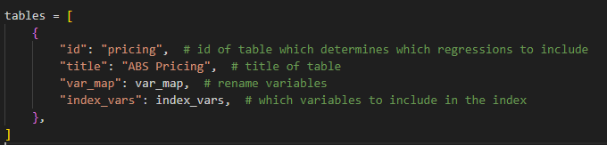
Code: Tables

Slide 10
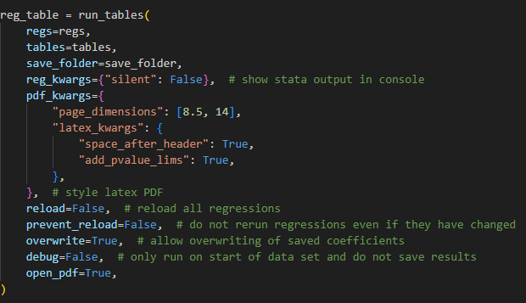
Code: Final Function

